Slide 1






Medicine Tracking and Distribution System
20
The Idea Igniters
Team members:
Arya Gandhi
Palak Deshmukh
Tamanna Shaikh
Shreyas Shinde
Pranav Madgul
Tanvesh Yeole

Slide 2
TABLE OF CONTENTS
01
Problem Statement
05
Theory of prioritization
02
Mind Mapping
06
Scamper Activity
03
Persona Construction
07
Journey Map
04
5W1H Activity details
08
Prototype Demonstrations

Slide 3

Problem Statement
Implementing app for medicine tracking and ditribution system with affordable prices for end users.

Slide 4
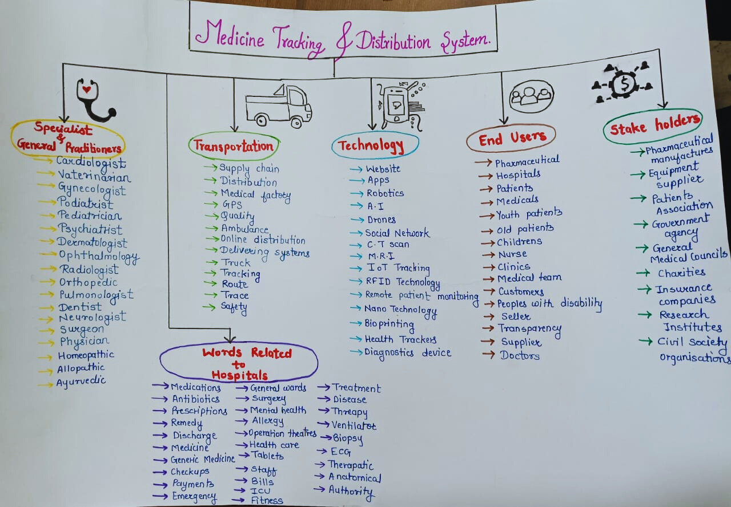
Mind Map

Slide 5
Persona (Youth)
Background
Motivation
1] He/She belongs to middle class family
2] He/She has supportive family.
3] May be he/she belongs to the age between 15-40.
1] Desire to manage or overcome his/her health condition.
2] Motivated to stay healthy for his/her family’s sake.
3] To travel to stress free/cheerful places.
Doubts/Fears
Challenges faced
1] Concern about how their health condition might affect their activities, ability to fit in.
2] May be a fear of becoming a burden to his/her family.
3] Fear for acceptance by society.
4] Has begun to experince issues related to going process
1] Getting out of depression.
2] May be lack of support from loved ones.
3]May be have faced social or emotional challenges.
4]May be having complex medical terminology .
Aspirations
1] To have good health and well being.
2] To easily manage medications.
3] To not be negative towords his/her future.
4] To reduce stress and anxiety.

Slide 6
Persona (Old age people)
Motivation
Background
1] Set realistic, short-term goals.
2] Inspired confidence with success stories.
3] Celebrate small victories.
1] May they belongs to age group between 55-75.
2] Maybe he/she is retired person.
3] Maybe they belongs from middle class family.
Doubts/Fears
1] Doubts that will those treatment work.
2] Maybe fear to try new treatment for therapy.
3] Fear of long term implications.
Challenges faced
1] Struggle to maintain balance diet.
2] Would that treatment be affordable or not.
3] Maybe having short-term memory loss.
Aspirations
1] To think positivity living life.
2] Enhancing daily living through better management of health conditions.

Slide 7
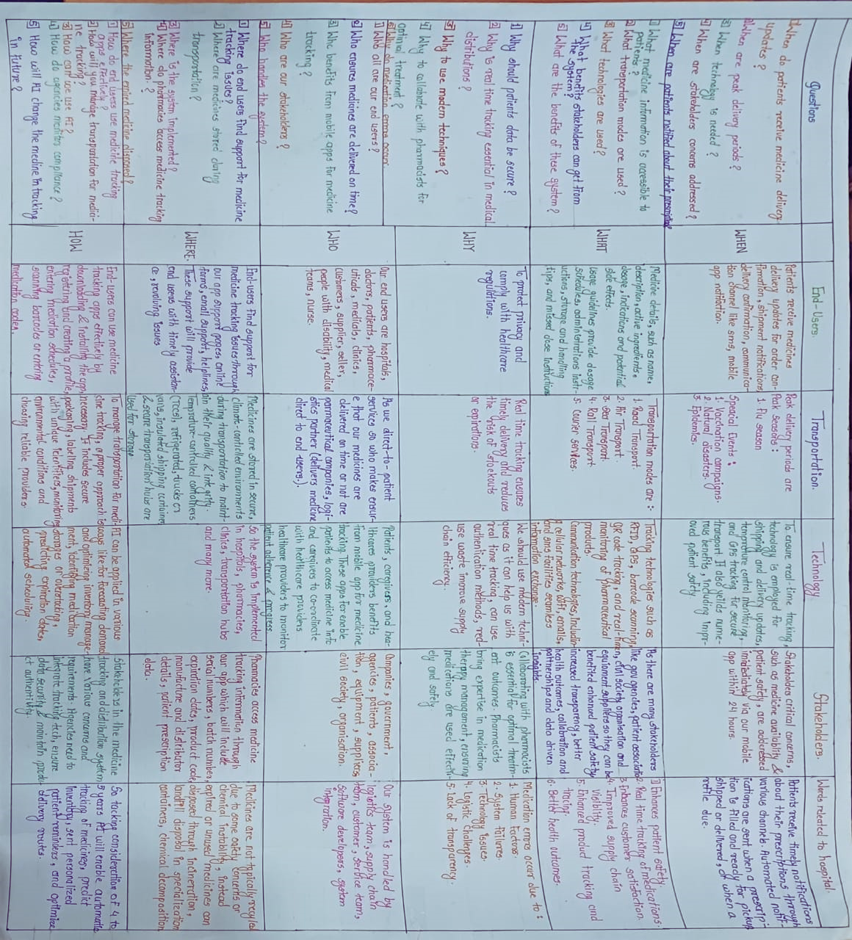
5
W
1
H
A
C
T
I
V
I
T
Y

Slide 8
Explanation:-
From the 5W1H activity we learned that we need a better system to
track and deliver medicines. What we found is:
1) What: We need a system to track medicines from start to finish.
2) Why: The current system is slow and expensive.
3) Who: It involves a lot of people, like those who make the medicines, those who
distributes them, doctors, and patients.
4)When: We should start using our system as soon as possible.
5) Where: This system will be used in all places where medicines are produced, stored,
and delivered.
6) How: We planned to use new technologies.
By going through this activity, we aim to make medicines more affordable and ensure
patients safety.

Slide 9

Priority list
Priority List | Tamanna | Arya | Palak | Shreyas | Tanvesh | Pranav | Total
Lack of technology | 1000 | 1000 | 1000 | 1000 | 100 | 1000 | 5100
Lack of communication | 1000 | 1000 | 1000 | 100 | 10 | 100 | 3210
Lack of Awareness | 100 | 1000 | 1000 | 1000 | 1000 | 1000 | 5100
Tracking issue | 1000 | 1000 | 100 | 1000 | 1000 | 100 | 4200
Human Error | 10 | 100 | 100 | 10 | 10 | 100 | 320
No real time tracking | 100 | 1000 | 1000 | 100 | 10 | 10 | 2220
Miscommunication with doctors | 1000 | 10 | 100 | 100 | 10 | 100 | 1320
Affordability | 1000 | 1000 | 1000 | 1000 | 1000 | 1000 | 6000
Data Errors | 100 | 100 | 100 | 100 | 100 | 1000 | 1500
Supply Chain Delays | 1000 | 100 | 100 | 1000 | 1000 | 1000 | 4200
Lack of Inventory management | 100 | 10 | 100 | 100 | 1000 | 100 | 1410

Slide 10
Access Control Issue | 100 | 100 | 10 | 100 | 100 | 100 | 510
Regular Survey Issue | 100 | 10 | 10 | 1000 | 10 | 1000 | 2130
Authenticity Issue | 1000 | 100 | 100 | 100 | 100 | 10 | 1410
Medication Errors | 100 | 1000 | 1000 | 100 | 1000 | 100 | 3300
Poor Reporting Issue | 100 | 100 | 100 | 100 | 100 | 1000 | 1500
Lack of Data Analytics | 10 | 100 | 1000 | 100 | 1000 | 100 | 2310
Distribution Errors | 100 | 1000 | 1000 | 1000 | 100 | 1000 | 4200
Limited Mobile Accessibility | 1000 | 1000 | 100 | 100 | 100 | 100 | 1500
Stockouts/overstocking | 10 | 100 | 100 | 100 | 1000 | 100 | 1410
High Workload | 100 | 100 | 100 | 1000 | 1000 | 1000 | 3300
Inadequate packaging or labeling | 1000 | 1000 | 1000 | 1000 | 100 | 100 | 4200
Lack of Transparency | 10 | 1000 | 1000 | 1000 | 100 | 10 | 3120
Patient Safety | 1000 | 1000 | 1000 | 1000 | 100 | 10 | 4110
Grey Market Trading | 100 | 1000 | 1000 | 1000 | 10 | 100 | 3210

Slide 11
SCAMPER:
Combine:
Let users track their health and connect it to the medicines they take.
Goal: Help users manage their health by combining medicine tracking with health records.
Adapt:
Create affordable mobile app to help with medicine tracking and connect with patients.
Goal: Help user access healthcare easily by finding affordable medicines.

Slide 12
JOURNEY MAP
Patients:
1] The patients will get to know about our app where they will get medicines with affordable prices.
2] Patients sign up in Medsync app.
3] As user can enable device location they will be able to share their current location to order medicines.
4] After looking into categories of medicines they will doubt that whether medicines provided are expired or not.
5] Patients feel fear to order medicines online.
6] They will get to know that price of m edicine is low than the actual price.
7] As already we are giving the medicines with less price we cannot provide any more discounts.
8] If the delivery is recieved after estimated time end users will be disappointed.
9] Patients feel that app is easy to use and understand.

Slide 13
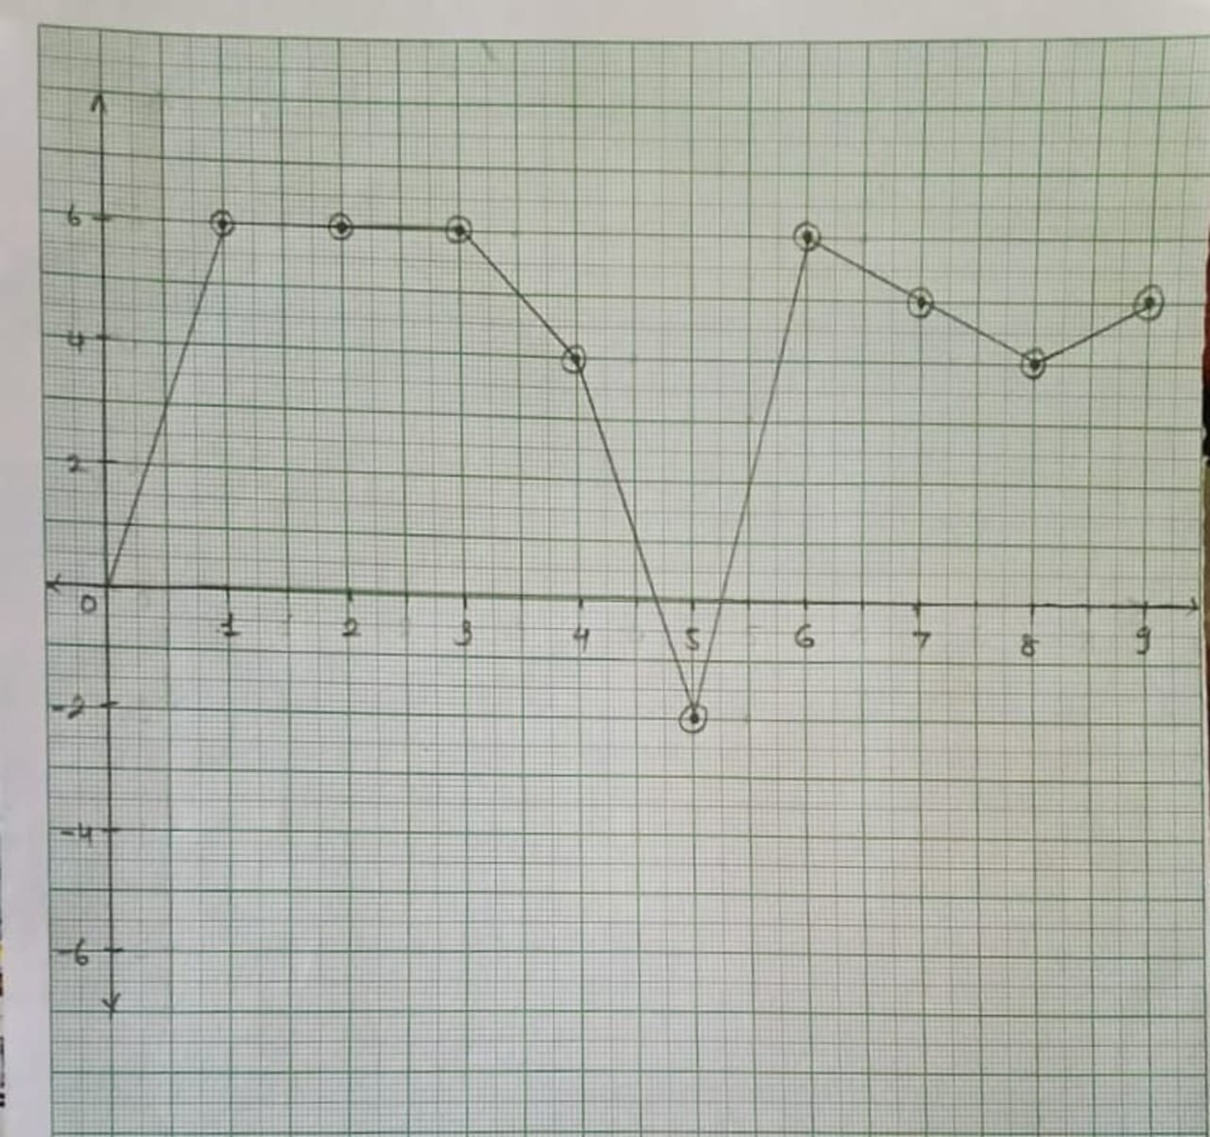

Slide 14
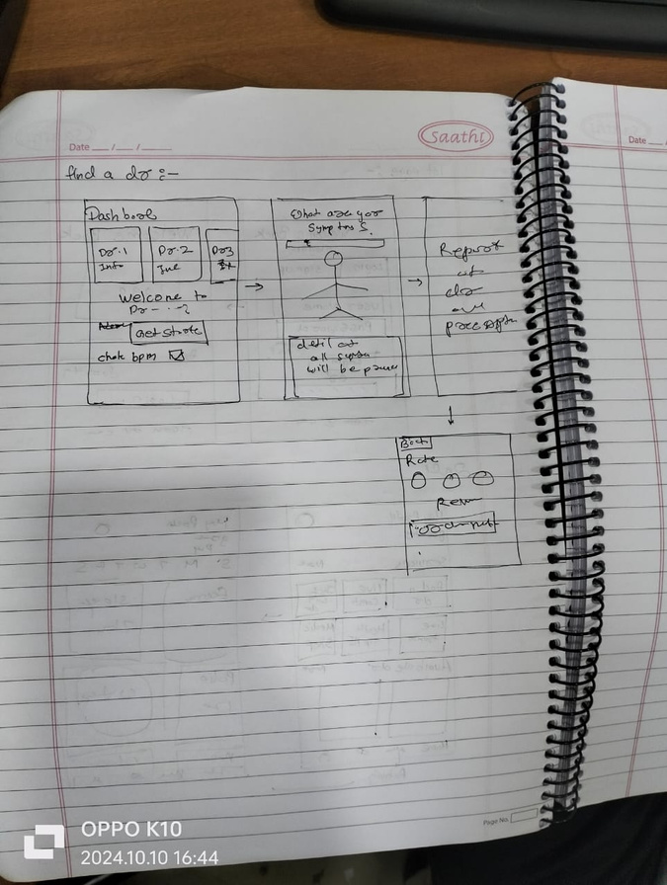
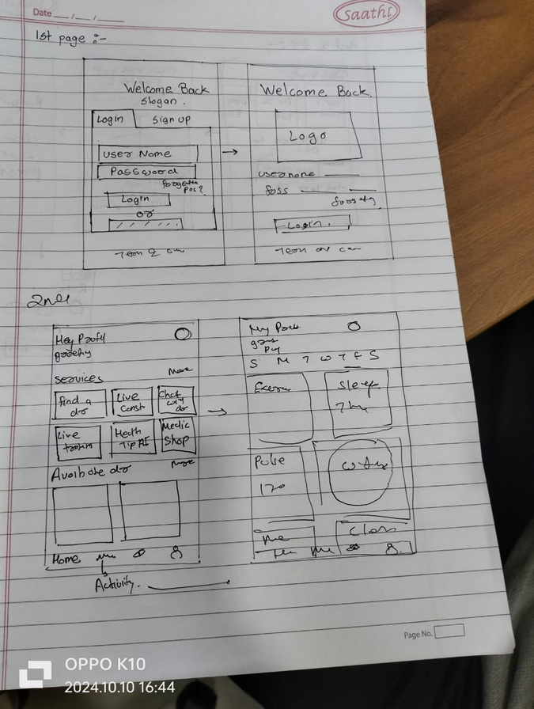
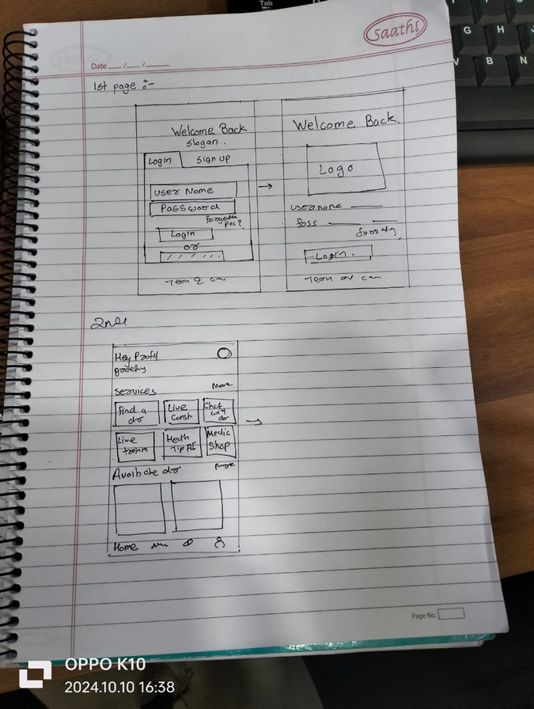
Prototype Demonstrations

Slide 15
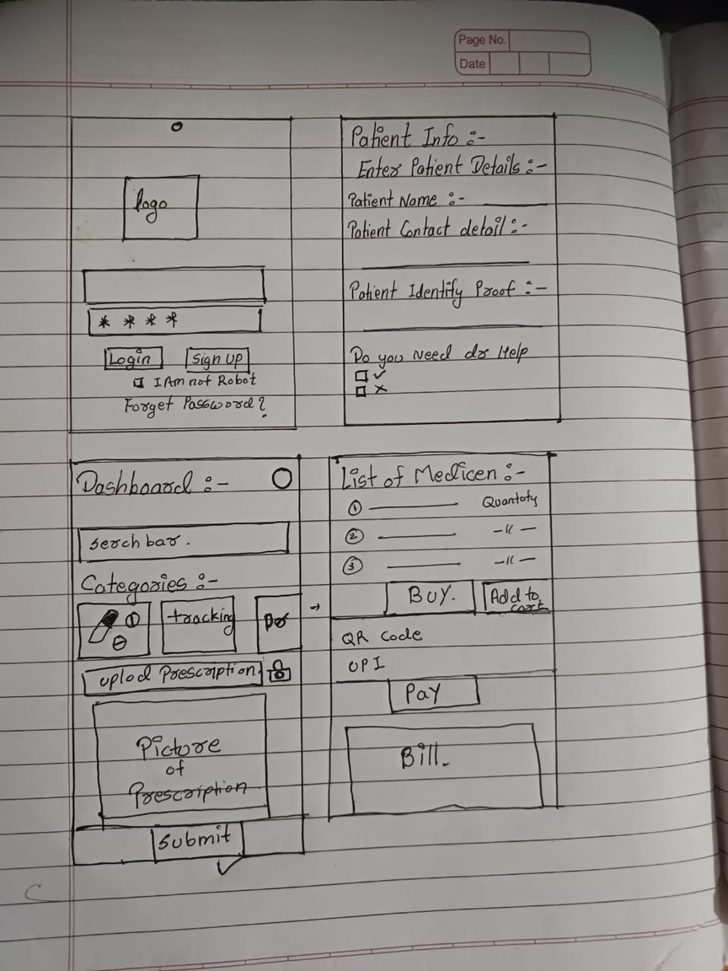
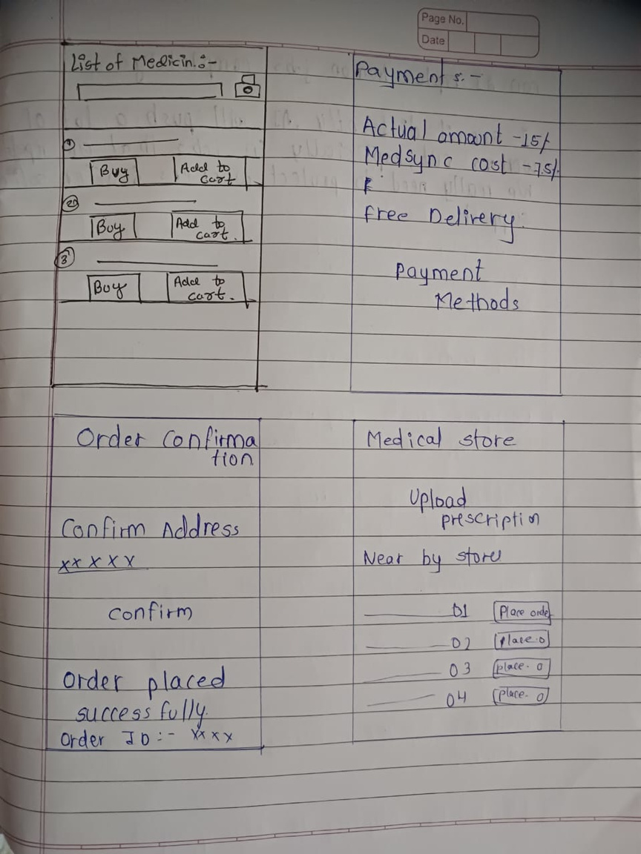

Slide 16
THANK YOU!!!

